Slide 1
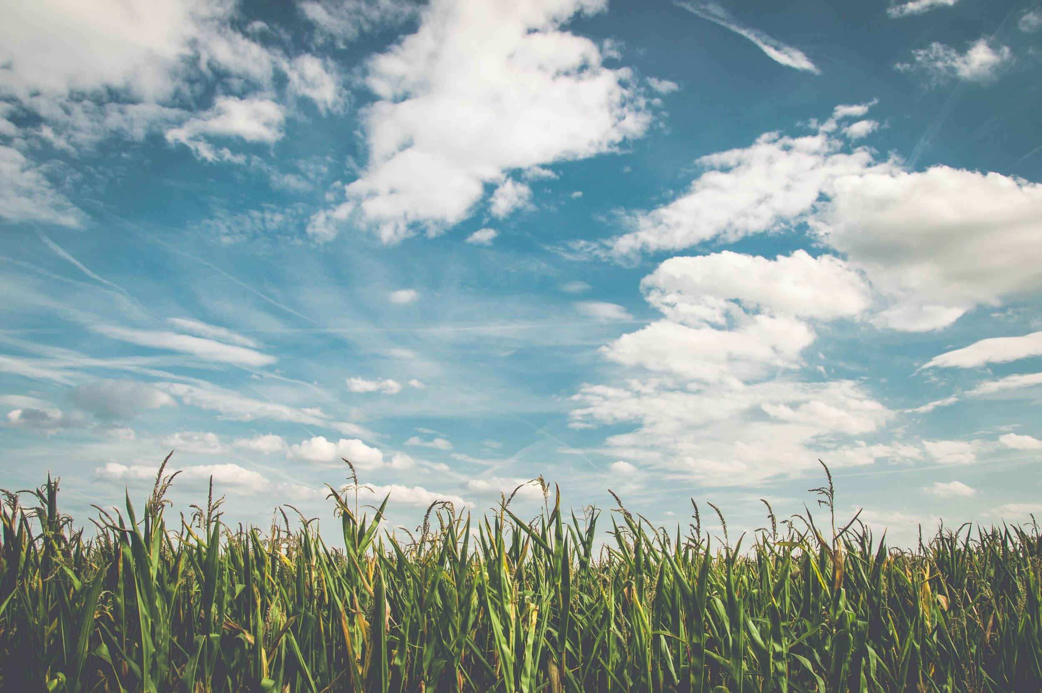
The need to automate the irrigation system
After hearing first hand experiences and reading from several sources online we discovered the plight of potato farmers and this served as the motivation behind our project.
Through our project we aimed to minimize the effort and surveillance that a potato farmer usually puts in his crops. Potatoes need a steady, season-long supply of water, but it's most important 6 to 10 weeks after planting, when the plants start to develop, A potato plant needs a dependable watering schedule and cool soil temperatures to produce desirable, evenly formed potatoes.Too much or too little water can impair tuber formation and jeopardize plant health.

Slide 2
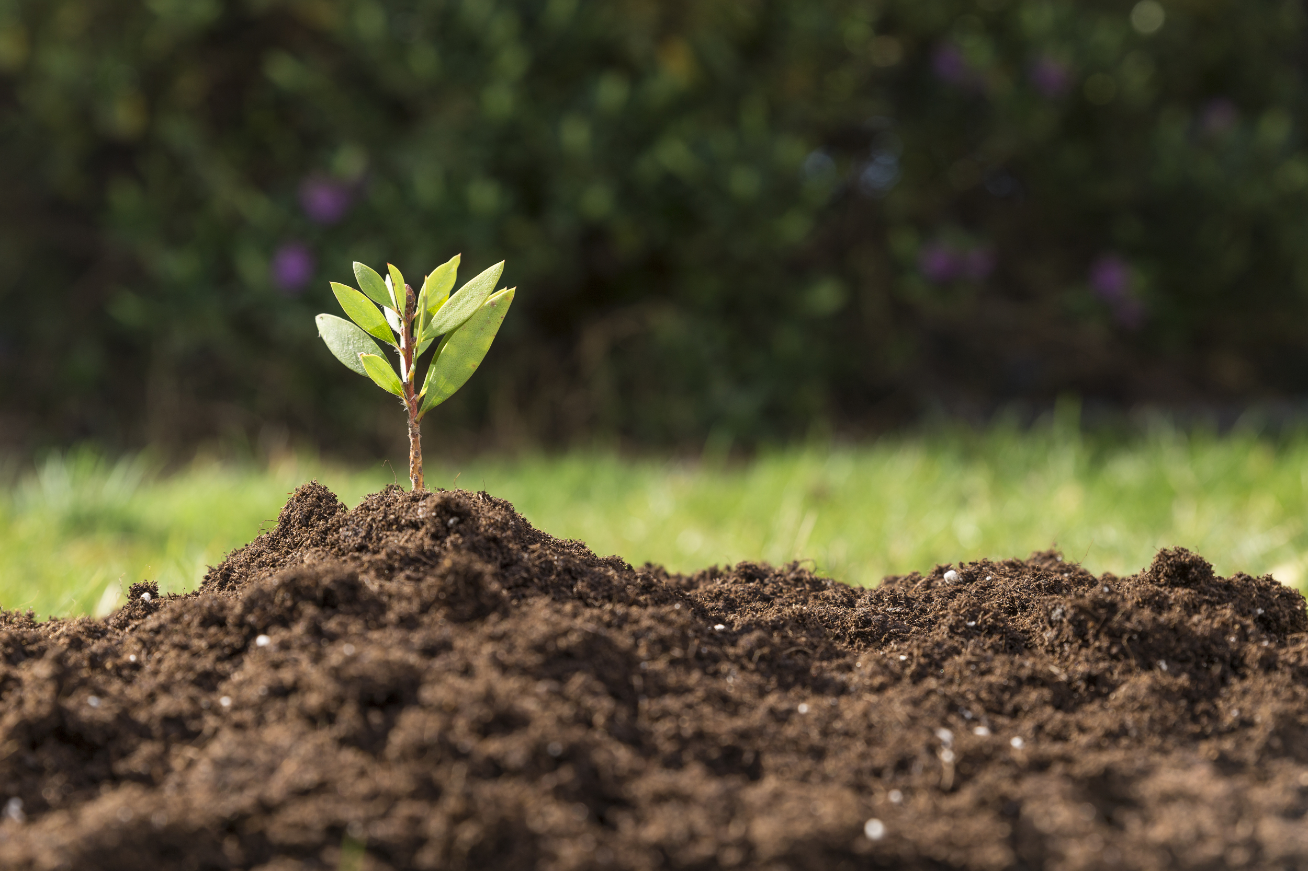
IRRIGATION SYSTEM USING IOT
Our project allows farmers equipped with smart phones to survey the water level at all times remotely and also set a threshold moisture level to automatically hold that moisture level intact throughout the season. The farmer also has the option to override this automation and control the irrigation system manually to conserve water. This helps him to avoid several trips down to the field every time he wishes to check and maintain the water level of the soil.

Slide 3
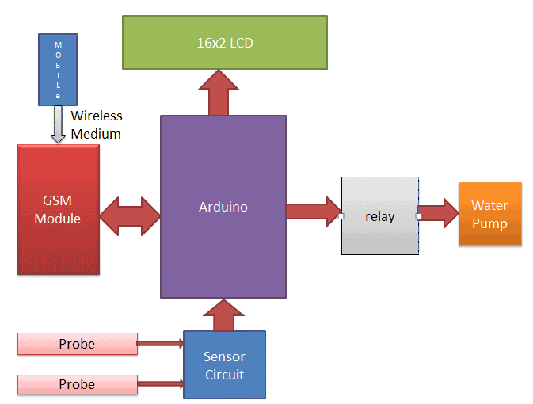
Overview

Slide 4
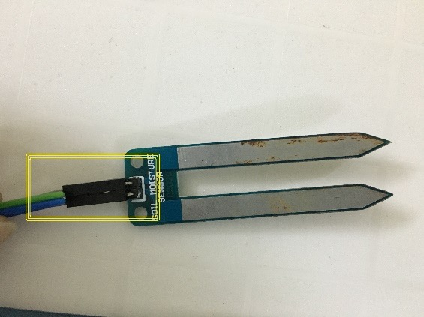
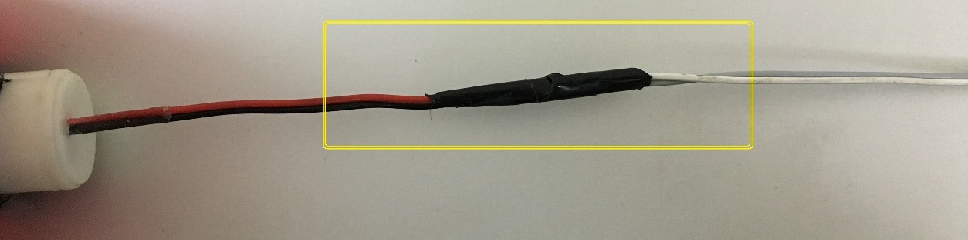
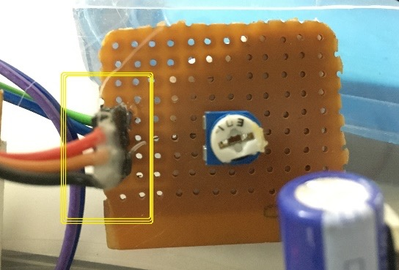
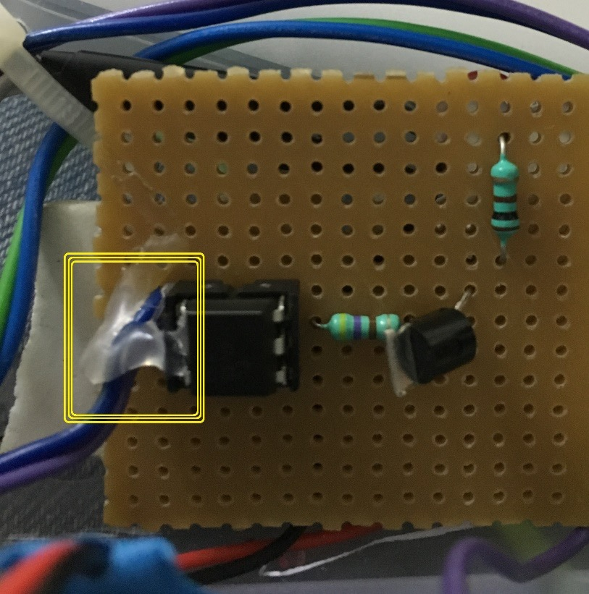
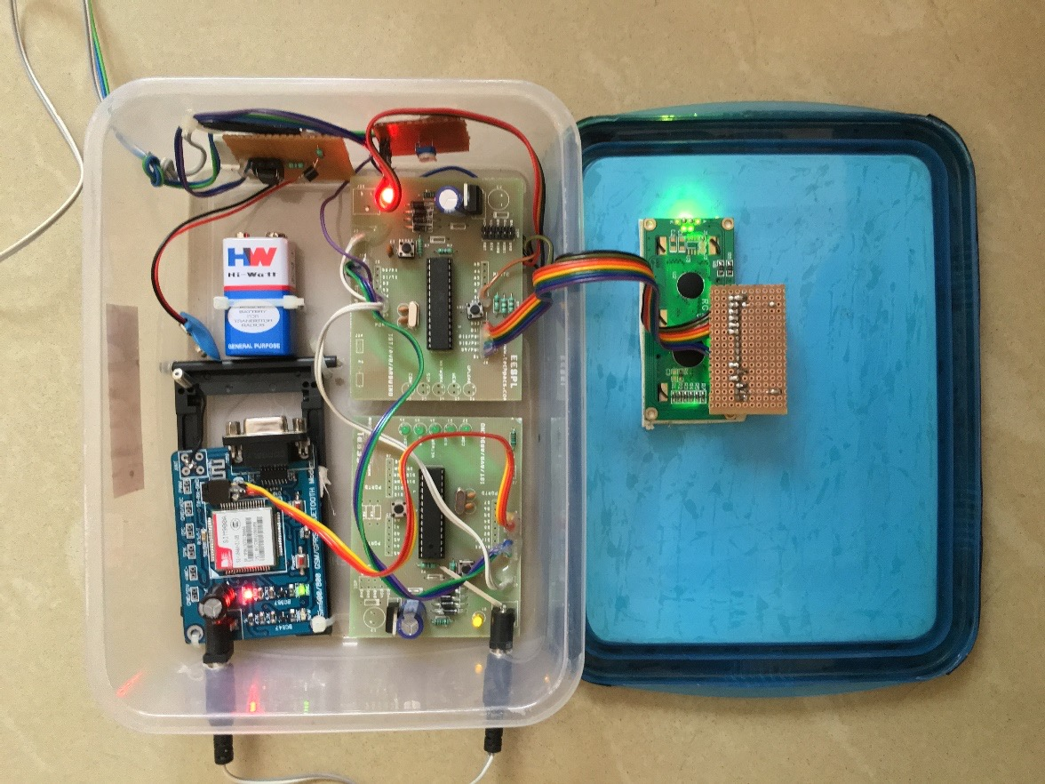
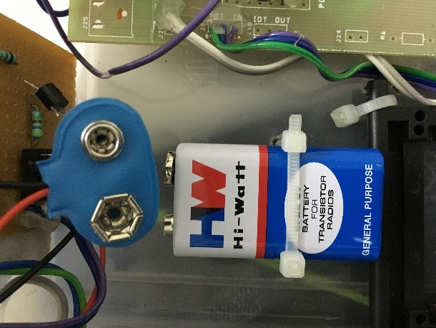
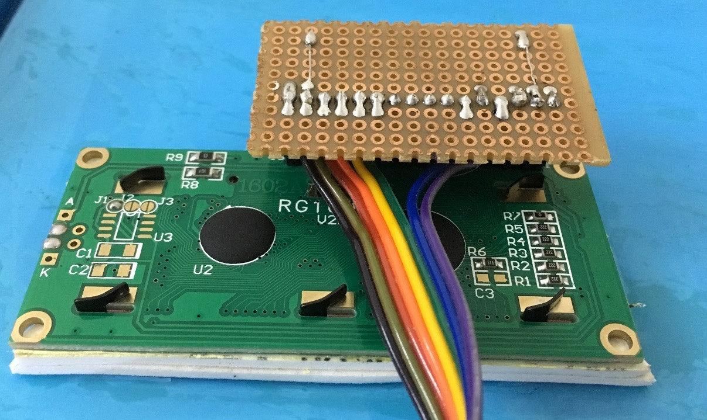
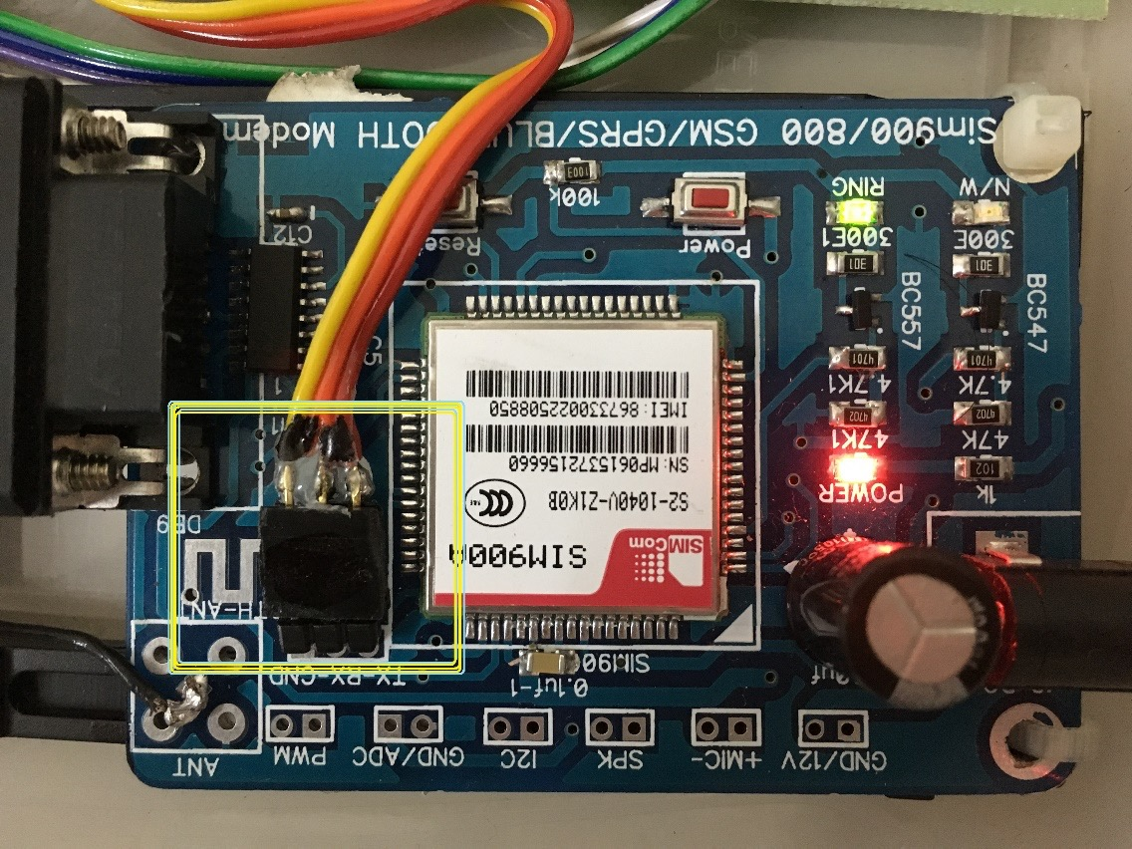
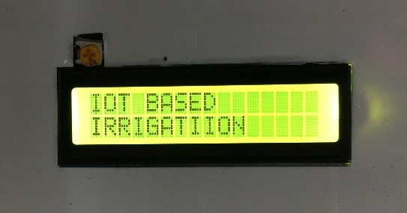
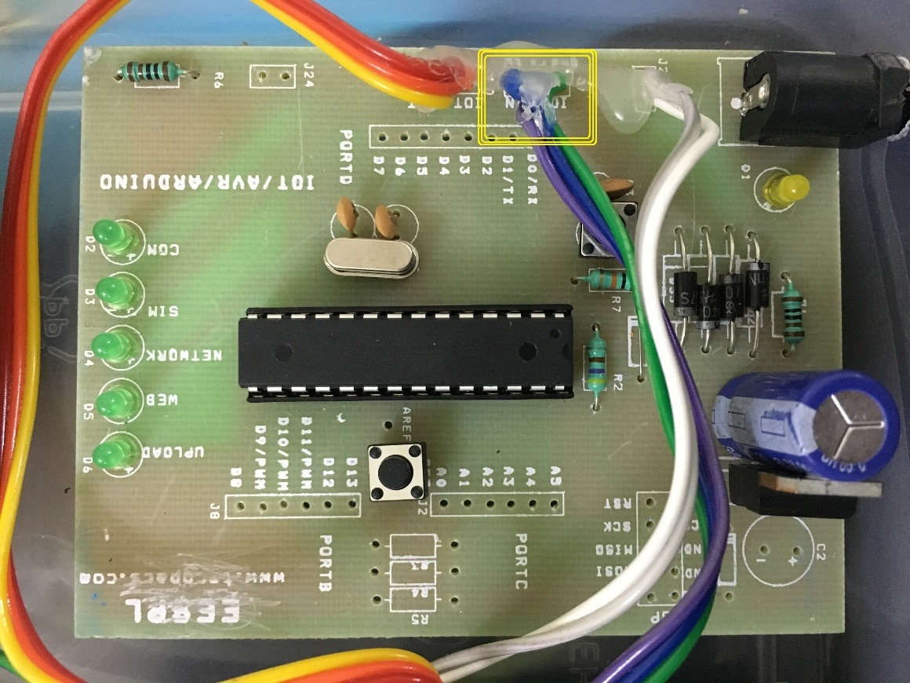
Components
Isolation/Amplification Unit
Pump
Analog to digital converter
Moisture sensor
Power supply unit
Microcontroller
SIM900 GPS/GPRS module`
Microcontroller

Slide 5
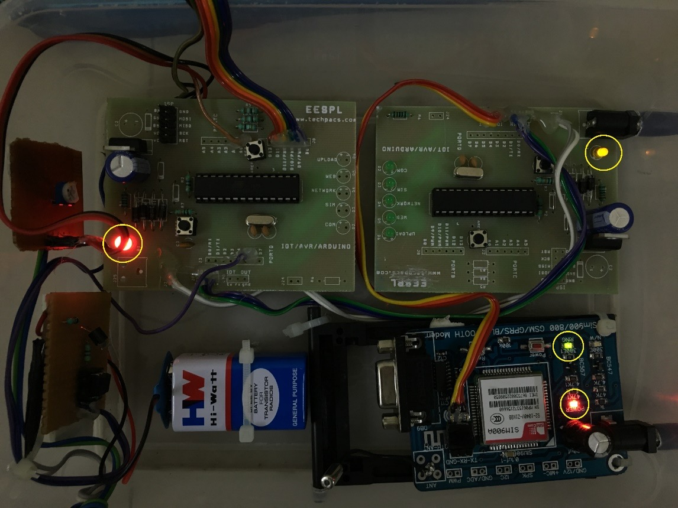
Turn on the main power supply and wait for the LCD to light up along with other indicators.
Power On

Slide 6
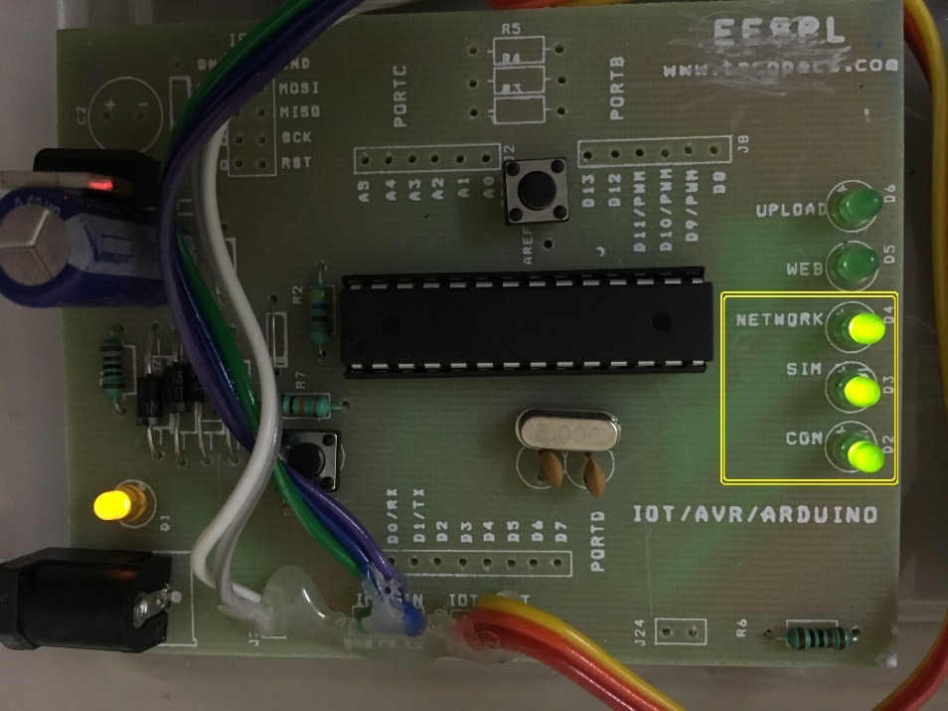
Connection
Sim
Network
Power On

Slide 7
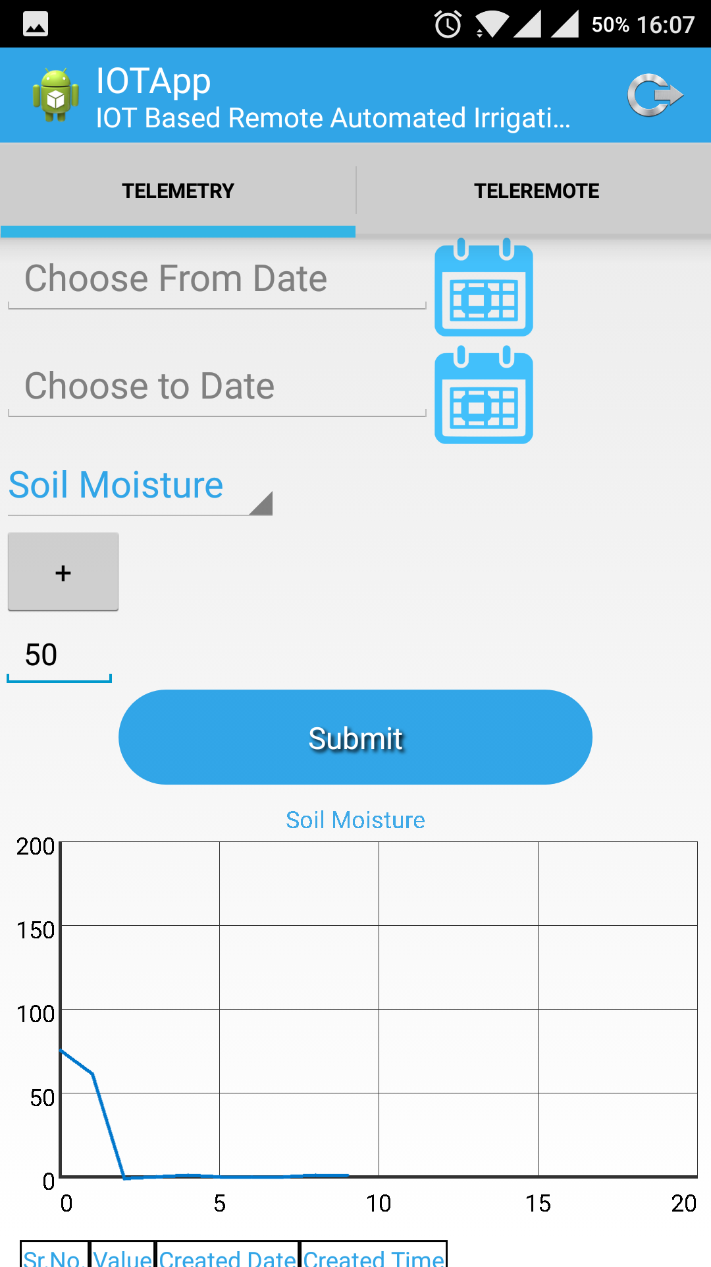
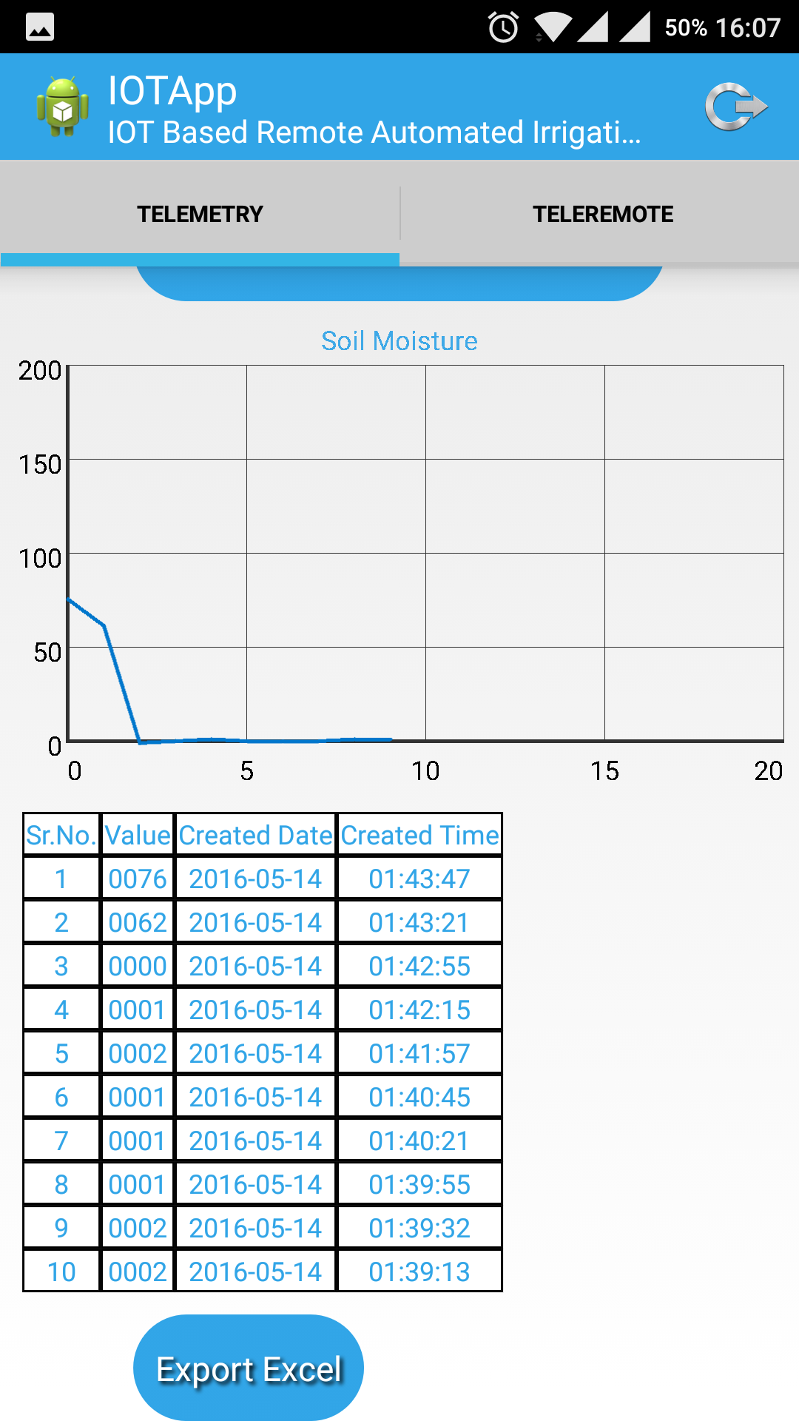
Iot App
This is where the moisture level is registered and represented in two formats:Graph form and Table form.
Also there is an option to set the moisture level to a certain specific amount.
These values change in real time and can be easily exported in excel format if required for further analysis.
Screen 1

Slide 8
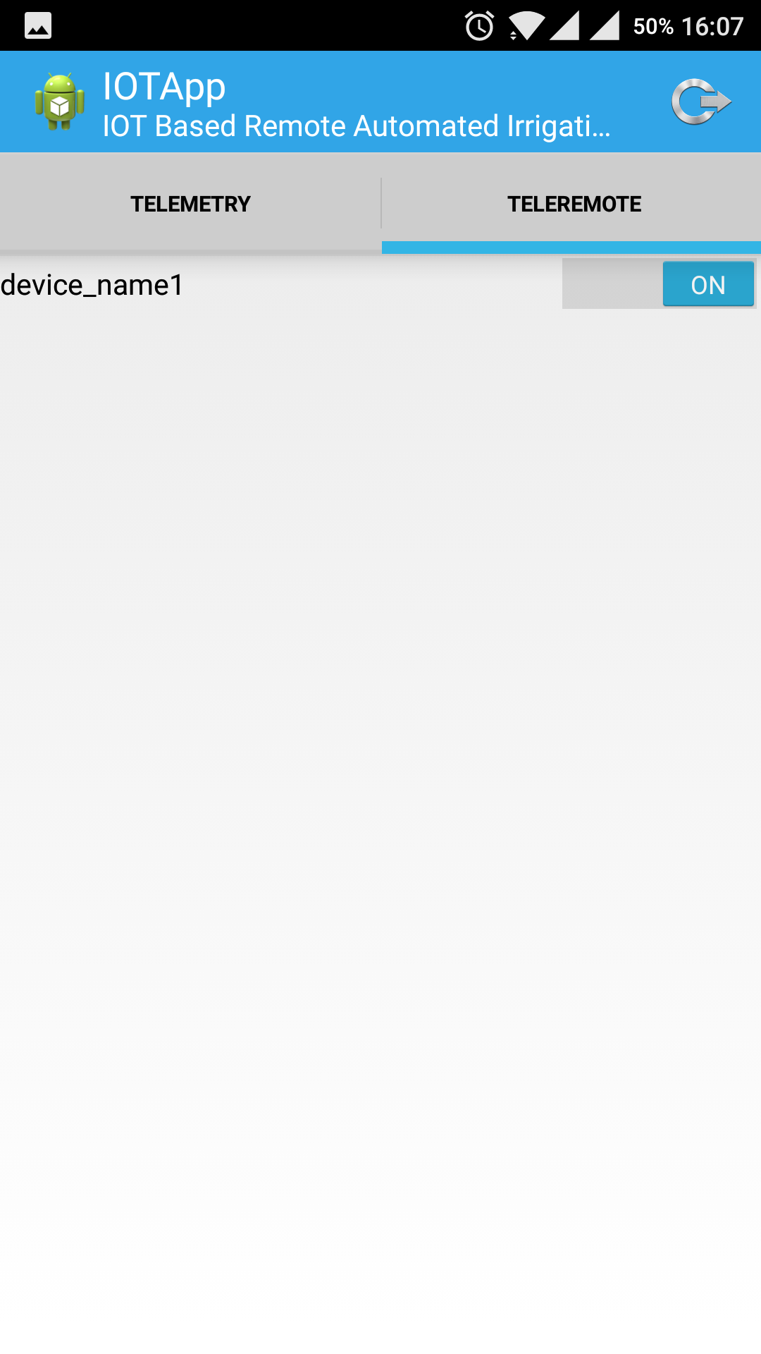
Iot App
This is the controller for the pump used in the irrigation system.
It can be turned on and off remotely as per the requirement of the farmer.
Screen 2

Slide 9
Scope
The data collected using this system can help in understanding the farming process better as at surveillance at each moment is possible.
Better irrigation methods can be implemented by studying the moisture levels of the soil.
It can also prove instrumental during the monsoon season by assisting the farmer to avoid crop failure by correctly gauging the water levels and issuing alerts in real time.

